Slide 1
A1 Chemistry
Arrangement of the Periodic Table; Electron configuration

Slide 3
Review
Okay, last lesson we set fire to some stuff.
The frequency of the colour emitted depends on the size of the gap an excited electron has to jump to get to the next energy level. The emitted light is that energy, once the excitement is over.

Slide 4
Learning Intentions
the structure of the periodic table is based on the atomic number and the properties of the elements
the location of electrons within atoms can be represented using electron configurations

Slide 5
Success criteria
Identify periods, groups and blocks of the periodic table.
Relate periods, groups and blocks of the periodic table to electron arrangements
Write electron configuration (shell only) for atoms and ions.

Slide 6
Key words
group
period
valence
block
shell
subshell
electron configuration
metalloid

Slide 7
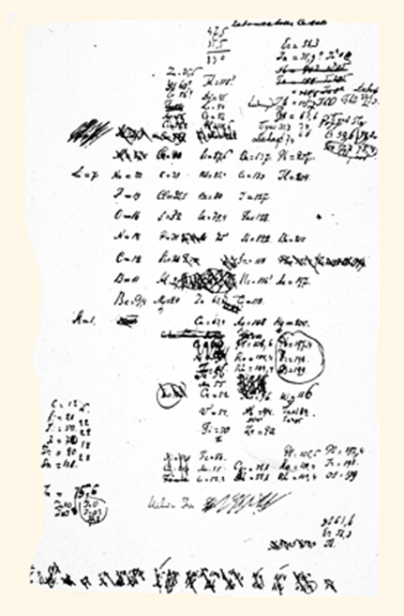

The Periodic Table
When Dmitri Mendeleev proposed his Periodic Table and Periodic Law in 1869, only 56 elements had been discovered.
His Periodic Table was one of many, but he was the first to predict the properties of as yet undiscovered elements.

Slide 8
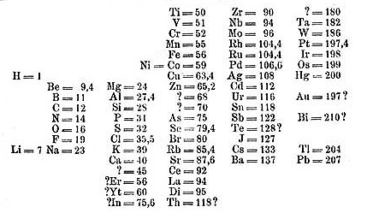
Initially elements were arranged in order by atomic weight (now atomic number), grouped by properties, which recurred periodically.

Slide 9
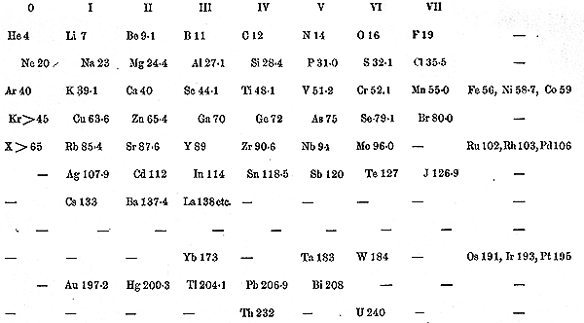
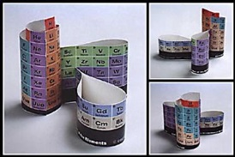
The Periodic Table has been improved and updated almost continuously , new elements were added, new groups were added as the noble gases were discovered and eventually new sections were added to make room for the discoveries made by the ‘atom smashers’ of the 1930s and beyond.

Slide 10
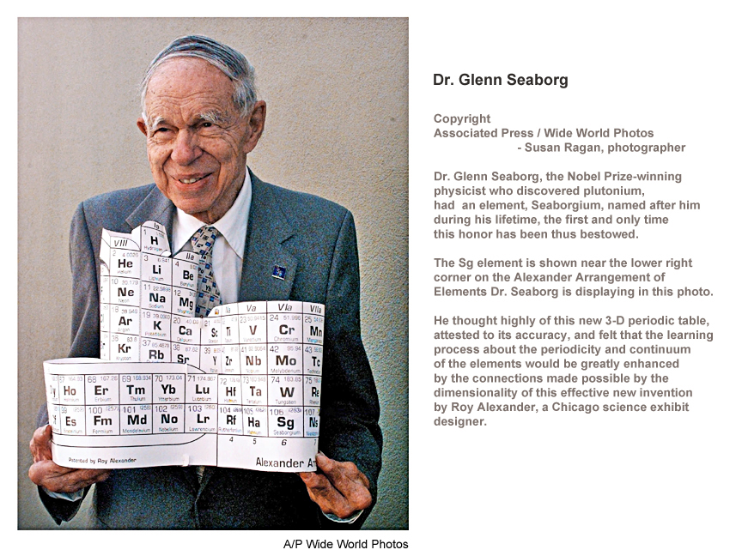

Slide 11
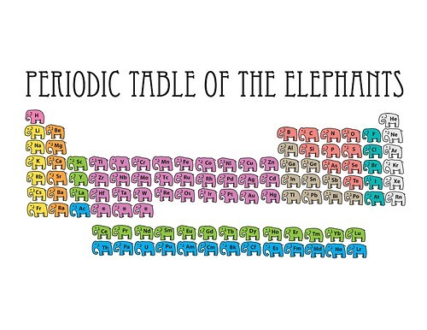

Slide 12
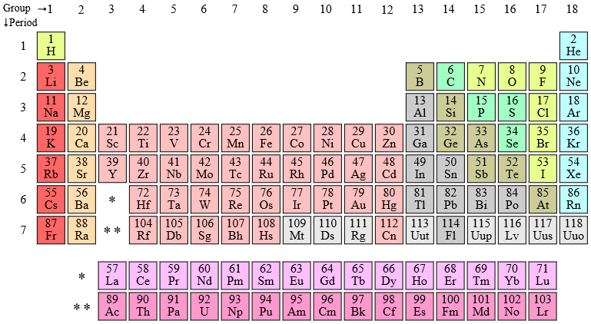
Groups
Vertical columns 1-18 (Formerly I-VII) represent chemical families, such as alkali metals, alkaline earth metals, halogens or noble gases.
Similar electron configurations in the valence (outside) shell.

Slide 13
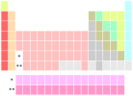


Slide 14
Periods
Horizontal rows 1-7
Elements in the same period (row) have the same number of electron shells.

Slide 15
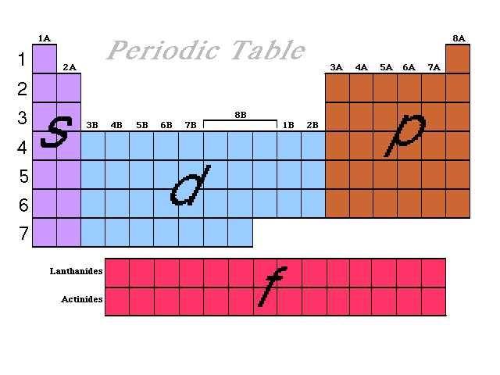
Blocks
Relates to the subshell location of the ‘last’ electron.

Slide 16
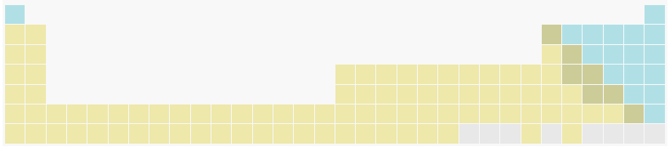
Metals/Non-metals

Slide 17
Interactive periodic table www.ptable.com

Slide 18
Success criteria
Identify periods, groups and blocks of the periodic table.
Relate periods, groups and blocks of the periodic table to electron arrangements
Write electron configuration (shell only) for atoms and ions.

